Slide 1
APOE genomics’ observation in Glioblastoma
Lijun Cheng report
08/12/2025

Slide 2
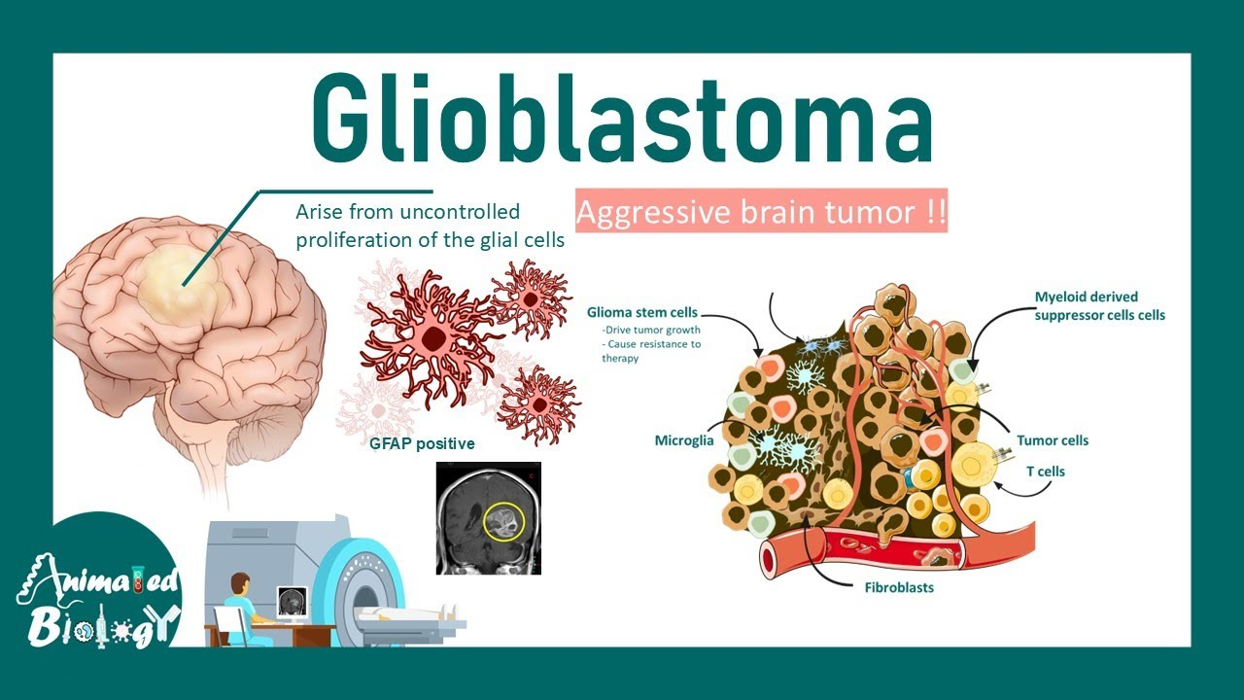

Slide 3
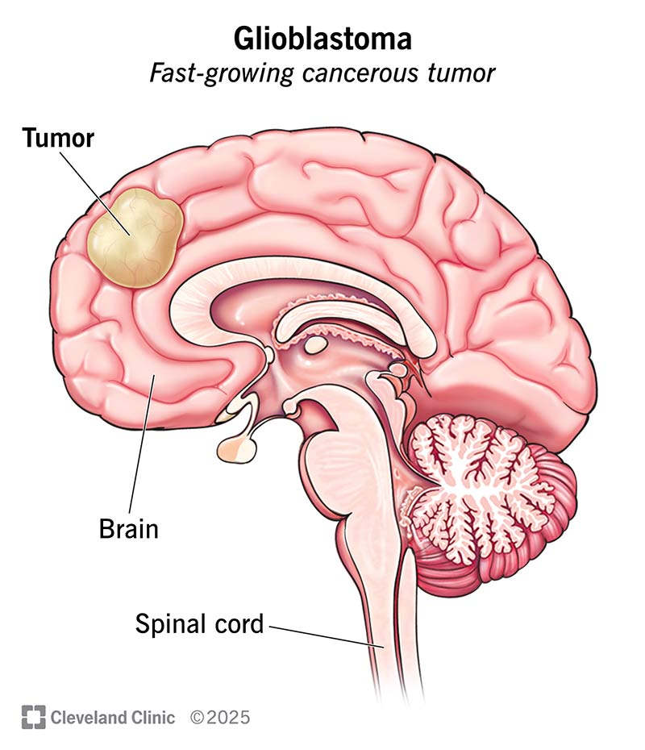
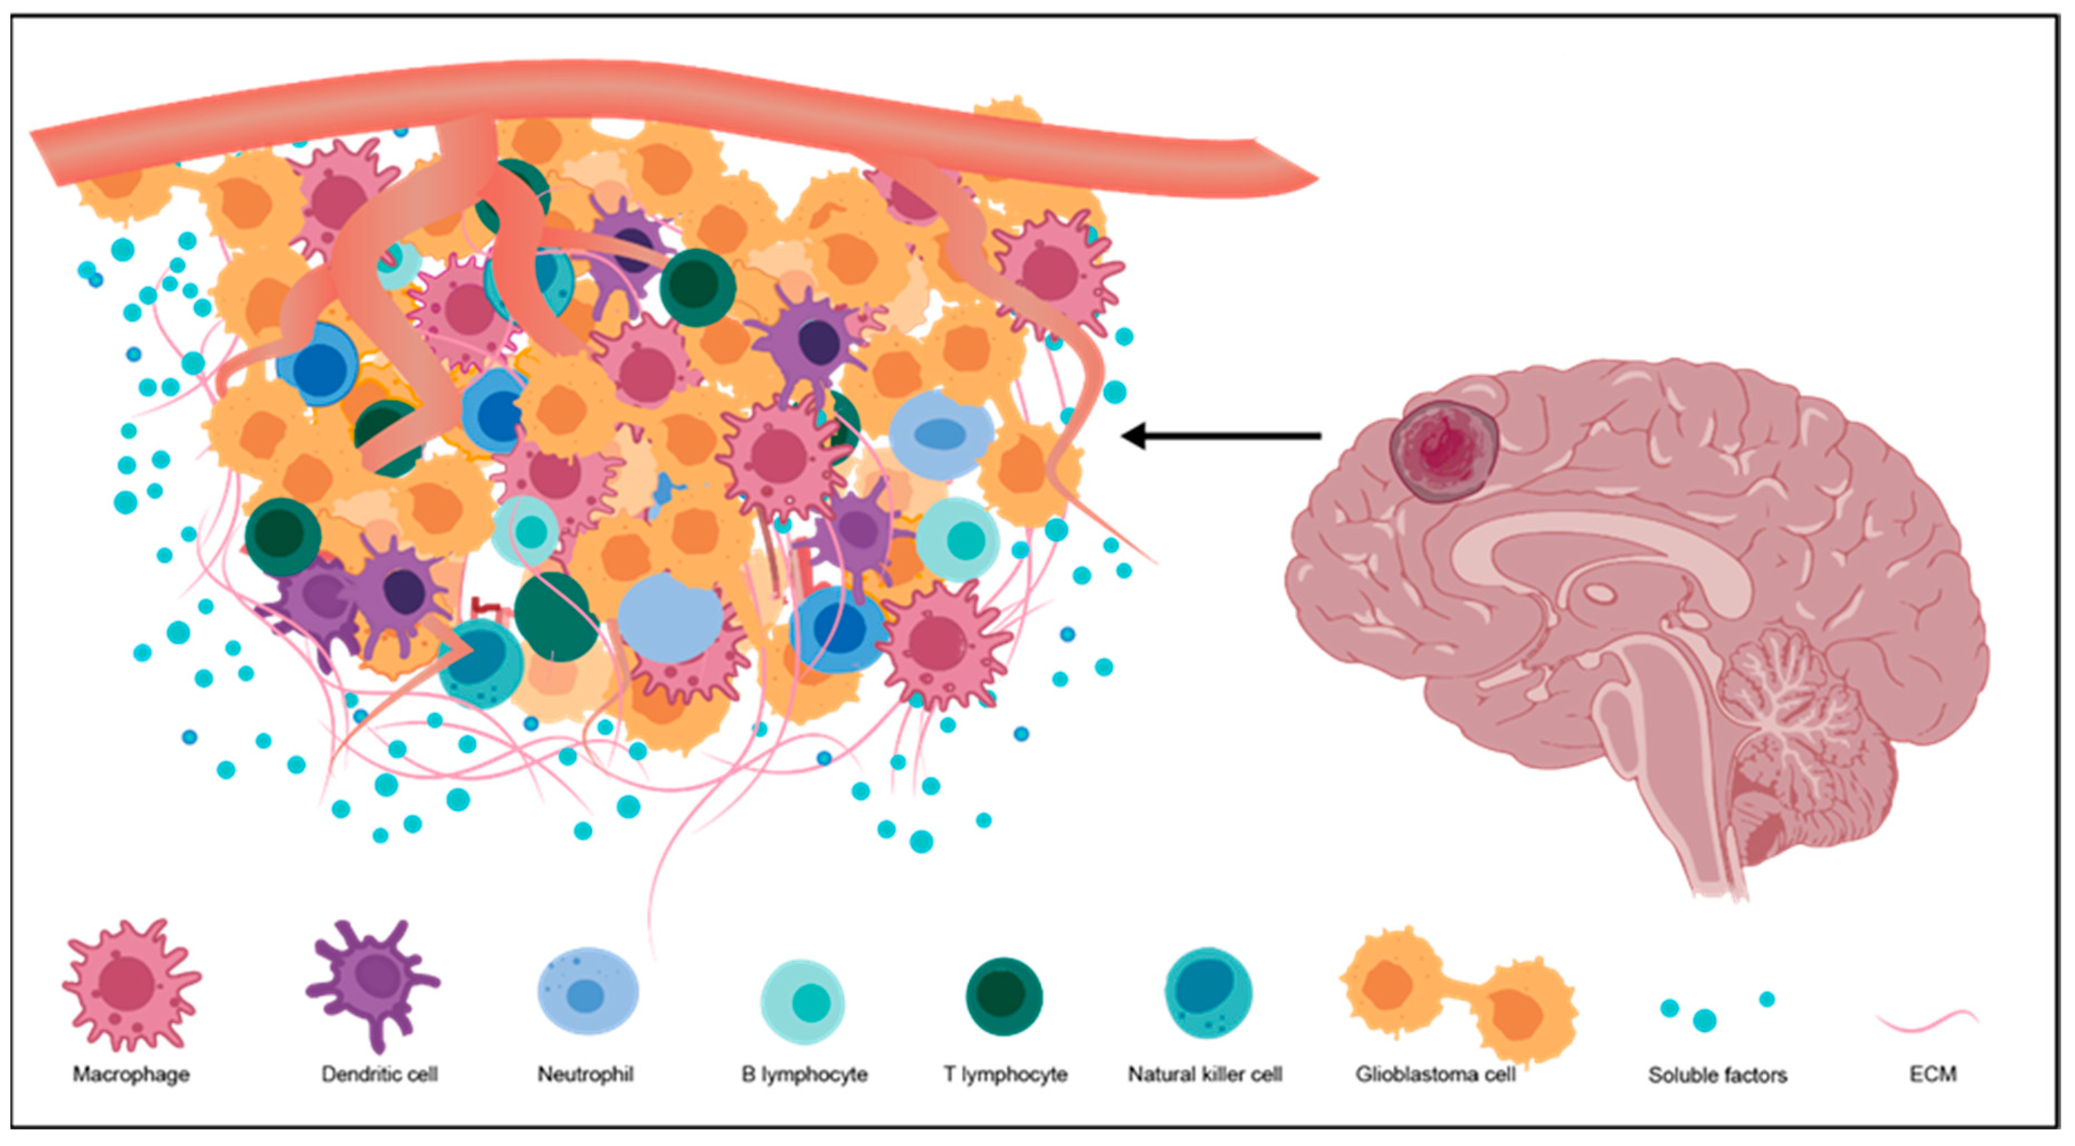
Glioblastoma
Figure 1. Components of the tumor microenvironment (TME) in glioblastoma.
Li, Xin, Wenting Gou, and Xiaoqin Zhang. 2024. "Neuroinflammation in Glioblastoma: Progress and Perspectives" Brain Sciences 14, no. 7: 687. https://doi.org/10.3390/brainsci14070687

Slide 4
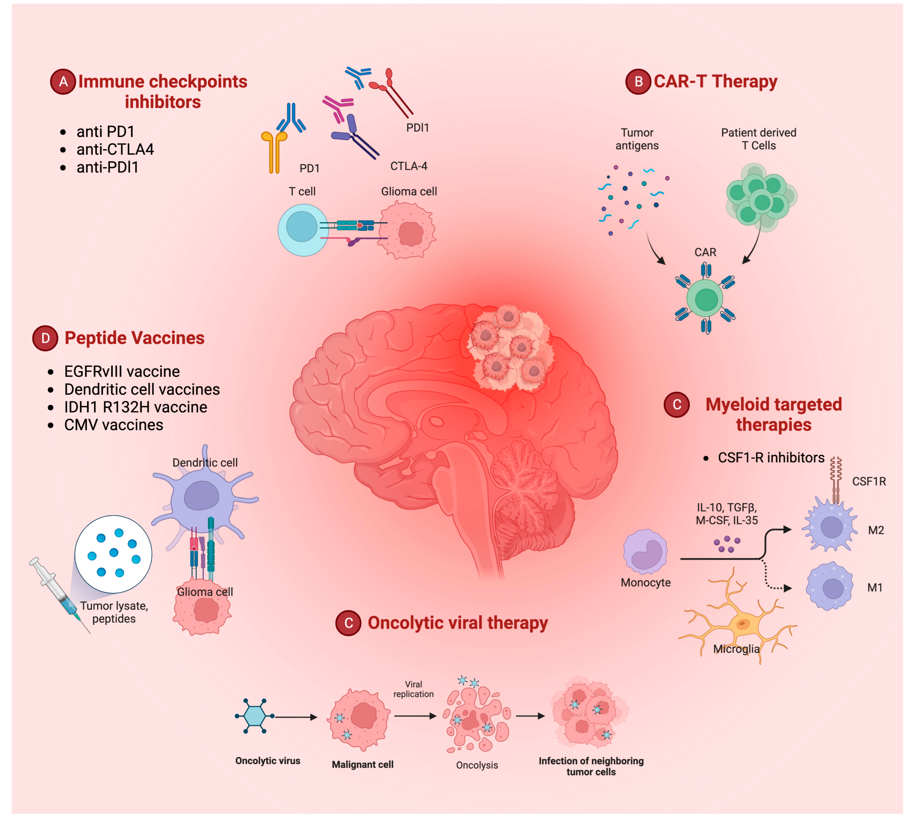
Bianconi, Andrea, Giuseppe Palmieri, Gelsomina Aruta, Matteo Monticelli, Pietro Zeppa, Fulvio Tartara, Antonio Melcarne, Diego Garbossa, and Fabio Cofano. 2023. "Updates in Glioblastoma Immunotherapy: An Overview of the Current Clinical and Translational Scenario" Biomedicines 11, no. 6: 1520. https://doi.org/10.3390/biomedicines11061520

Slide 5
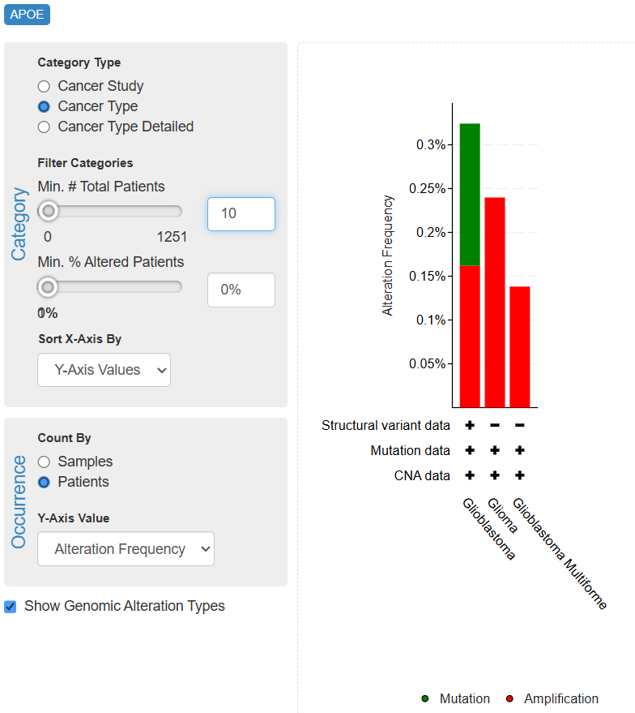
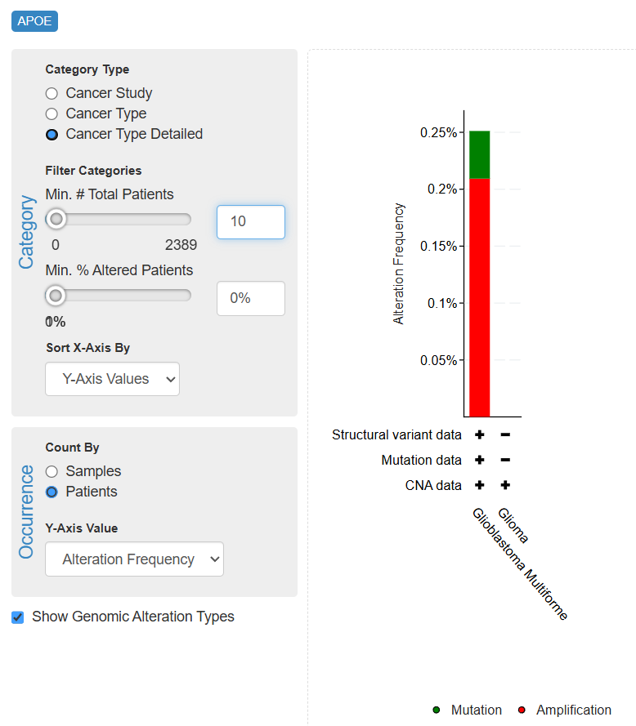
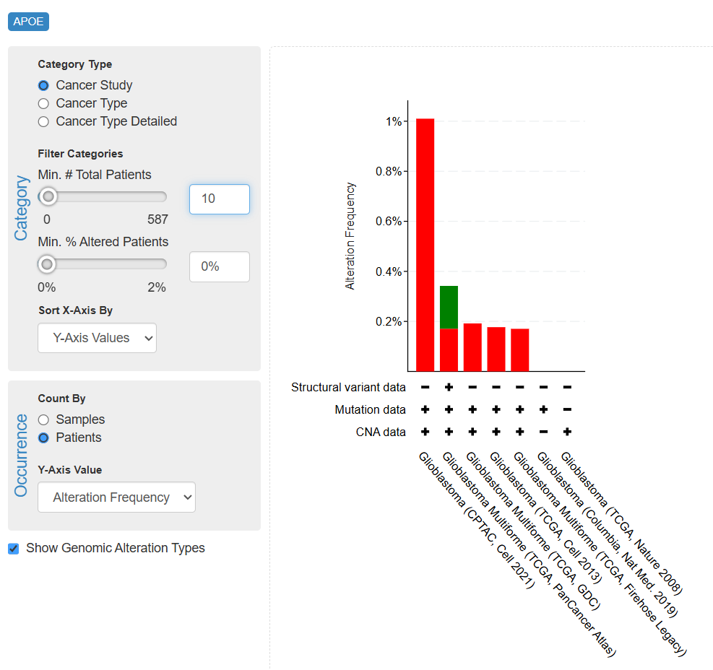
Research study
APOE in 2754 GBM patients, mutation rate observation
Querying 2754 GBM samples / 2721 patients in 7 studies , APOE
Mutation includes
Mutation:SNP
Amplification: CVN
Structure variation

Slide 6
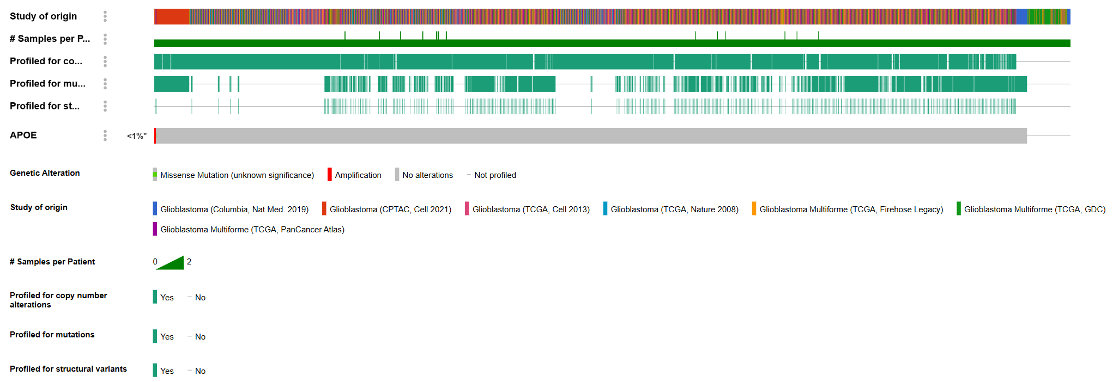
APOE in 2754 GBM patients, mutation rate observation
Querying 2754 GBM samples / 2721 patients in 7 studies , APOE
CVN
Mutation
structure variation
APOE mutation rate in GBM is <1%.

Slide 7
Conclusions
APOE mutation is not variated in GBM , hence isoform of APOE mutation is not value to observe further
APOE gene expression is significantly variated in GBM

Slide 8
APOE potential function in APP-PS1 mouse model

Slide 9
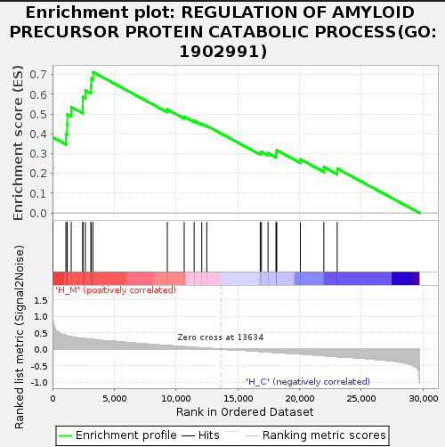
Hippocampus
🧬 01. GO:1902991 — Regulation of Amyloid Precursor Protein Catabolic Process淀粉样蛋白前体分解代谢过程的调控
The regulation of amyloid precursor protein (APP) catabolic process refers to any biological process that modulates the frequency, rate, or extent of the breakdown (catabolism) of APP — a transmembrane protein whose cleavage products play central roles in neurodevelopment, synaptic function, and neurodegenerative diseases, particularly Alzheimer's disease (AD).
基因本体论定义：淀粉样蛋白前体 (APP) 分解代谢过程的调控是指任何调节 APP 分解（分解代谢）频率、速率或程度的生物过程。APP 是一种跨膜蛋白，其裂解产物在神经发育、突触功能和神经退行性疾病（尤其是阿尔茨海默病 (AD)）中发挥着核心作用。
03.Result_X101SC24106039-Z01-J001_Mus_musculus\Result_X101SC24106039-Z01-J001_Mus_musculus\5.Enrichment\1.GO\H_MvsH_C\GSEA\H_M

Slide 10
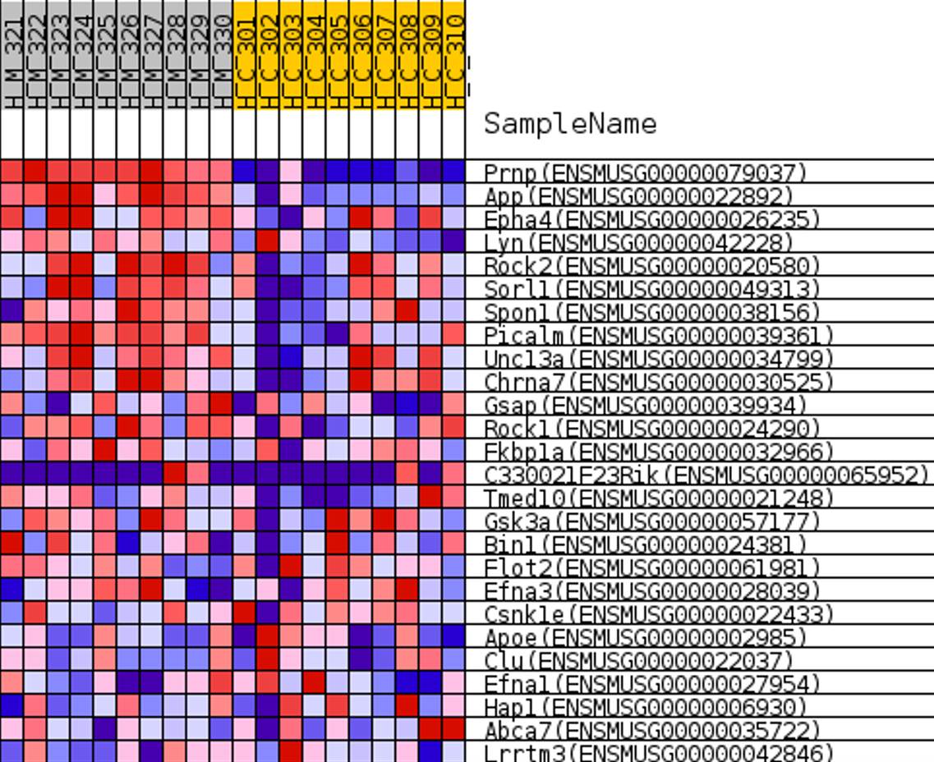
Hippocampus
🧬 01. GO:1902991 — Regulation of Amyloid Precursor Protein Catabolic Process淀粉样蛋白前体分解代谢过程的调控
🔬 分子功能和机制背景
APP 分解代谢是指淀粉样蛋白前体被水解成各种片段的过程。该过程受到严格调控，不同蛋白水解途径之间的平衡决定了是否产生神经毒性的淀粉样β蛋白 (Aβ)。
🔁 APP 分解代谢途径主要有两条：
✳️ 1. 非淀粉样变性途径（保护性）
• α-分泌酶在 Aβ 区域内裂解 APP → 阻止 Aβ 形成。
• 生成可溶性 APP-α (sAPPα) 和 C 末端片段 (CTF-α)。
• 进一步被 γ-分泌酶裂解 → 释放 p3 肽（无毒）。
➡️ 调节该途径可减少 Aβ 负担并促进神经保护。
✳️ 2. 淀粉样变性途径（病理学）
• β-分泌酶 (BACE1) 裂解 APP → 形成可溶性 APP-β (sAPPβ) 和 CTF-β。
• γ-分泌酶裂解 CTF-β → 释放 Aβ40/42 肽。
o Aβ42 极易聚集，且具有神经毒性 (APOE)。
➡️ 该途径的上调会通过 Aβ 积聚、斑块形成和神经毒性导致阿尔茨海默病。

Slide 11
⚙️ APP 分解代谢的调控机制
Hippocampus
🧬 01. GO:1902991 — Regulation of Amyloid Precursor Protein Catabolic Process淀粉样蛋白前体分解代谢过程的调控
Mechanism | Key Players关键参与者 | Function
Enzyme activity regulation功能酶活性调控 | ADAM10 (α-secretase), BACE1 (β-secretase), PSEN1/PSEN2 (γ-secretase) | Control cleavage specificity and rate控制裂解特异性和速率
Trafficking and localization of APP APP 的运输和定位 | SORL1, LRP1, RAB11 | Determine whether APP is cleaved in endosomes, lysosomes, or at the membrane 确定 APP 是在内体、溶酶体还是膜上被裂解
Phosphorylation of APP APP 的磷酸化 | CDK5, GSK3β | Modulates APP's conformation and accessibility to secretases 调节 APP 的构象和对分泌酶的可及性自噬和溶酶体降解
Autophagy and lysosomal degradation 自噬和溶酶体降解 | TFEB, LAMP1, CTSD | Regulate APP degradation vs. Aβ accumulation 调节 APP 降解与 Aβ 积累
ER stress and oxidative damage 内质网应激和氧化损伤 | ATF4, PERK, ROS | Alter APP processing under cellular stress改变细胞应激下的 APP 加工

Slide 12
⚙️ APP 分解代谢的调控机制 Genes Involved in Regulation
Hippocampus
🧬 01. GO:1902991 — Regulation of Amyloid Precursor Protein Catabolic Process淀粉样蛋白前体分解代谢过程的调控
Gene | Role | 基因作用
BACE1 | β-secretase initiating amyloidogenic APP cleavage | β-分泌酶启动淀粉样变性APP裂解
ADAM10 | α-secretase promoting non-amyloidogenic cleavage | ADAM10 α-分泌酶促进非淀粉样变性裂解
PSEN1/PSEN2 | γ-secretase subunits determining Aβ species | γ-分泌酶亚基决定Aβ种类
SORL1 | Guides APP to non-amyloidogenic compartments | 引导APP进入非淀粉样变性区室
GSK3B | Regulates APP phosphorylation and trafficking | 调节APP磷酸化和运输
TFEB | Enhances lysosomal degradation of APP/Aβ | 增强APP/Aβ的溶酶体降解
APOE | Modulates Aβ clearance (especially APOE4 variant) | 调节Aβ清除（尤其是APOE4变体）
NEDD9, CDK5 | Affect trafficking and proteolysis through kinase activity | 通过激酶活性影响运输和蛋白水解

Slide 13
⚙️ APP 分解代谢的调控机制 Genes Involved in Regulation
Hippocampus
🧬 01. GO:1902991 — Regulation of Amyloid Precursor Protein Catabolic Process淀粉样蛋白前体分解代谢过程的调控
Gene | Role | 基因作用
BACE1 | β-secretase initiating amyloidogenic APP cleavage | β-分泌酶启动淀粉样变性APP裂解
ADAM10 | α-secretase promoting non-amyloidogenic cleavage | ADAM10 α-分泌酶促进非淀粉样变性裂解
PSEN1/PSEN2 | γ-secretase subunits determining Aβ species | γ-分泌酶亚基决定Aβ种类
SORL1 | Guides APP to non-amyloidogenic compartments | 引导APP进入非淀粉样变性区室
GSK3B | Regulates APP phosphorylation and trafficking | 调节APP磷酸化和运输
TFEB | Enhances lysosomal degradation of APP/Aβ | 增强APP/Aβ的溶酶体降解
APOE | Modulates Aβ clearance (especially APOE4 variant) | 调节Aβ清除（尤其是APOE4变体）
NEDD9, CDK5 | Affect trafficking and proteolysis through kinase activity | 通过激酶活性影响运输和蛋白水解

Slide 14
Hippocampus
🧬 01. GO:1902991 — Regulation of Amyloid Precursor Protein Catabolic Process淀粉样蛋白前体分解代谢过程的调控
🧠 与疾病的相关性
Disease | Role of This Pathway | 该通路在疾病中的作用
Alzheimer’s disease (AD) | Imbalance in APP catabolism leads to Aβ accumulation and plaque formation | 阿尔茨海默病 (AD) APP 分解代谢失衡导致 Aβ 积聚和斑块形成
Down syndrome | Trisomy 21 leads to APP overexpression and early-onset AD | 唐氏综合征, 三体21综合征导致 APP 过表达和早发性 AD
NPSLE (Neuropsychiatric Lupus) | Inflammatory signaling and oxidative stress may dysregulate APP cleavage, mimicking AD-like pathology | 神经精神性狼疮 (NPSLE) 炎症信号和氧化应激可能导致 APP 裂解失调，从而类似于 AD 样病理

Slide 15
APOE study in GEO datasets
projectname | Project | case.diseasestate | case.tissue | Comparison category | Comparison contrast
GSE40156 | MouseDisease | atherosclerosis动脉粥样硬化 | aorta主动脉 | Other Comparisons | AnimalStrain:Tissue:Age[weeks] => B6.129P2-Apoetm1Unc/J:aorta -> 32 vs 6动物品系:组织:年龄[周] => B6.129P2-Apoetm1Unc/J:主动脉 -> 32 vs 6
GSE163657 | MouseDisease | atherosclerosis | aorta | Other Comparisons | SubjectTreatment:TreatTime[weeks]:Genotype => chow diet:22 -> APOE-/- vs wild type
GSE40156 | MouseDisease | atherosclerosis | aorta | Other Comparisons | Age[weeks]:Tissue:AnimalStrain => 32:aorta -> B6.129P2-Apoetm1Unc/J vs C57BL/6J
GSE163657 | MouseDisease | atherosclerosis | aorta | Treatment1 vs. Treatment2 | Genotype:SubjectTreatment:TreatTime[weeks] => APOE-/-:western diet -> 22 vs 6
GSE117588 | HumanDisease | Alzheimer's disease (AD) | cerebral organoid | Tissue1 vs. Tissue2 | GeneticModification => CRISPR/Cas9 induced APOE E3:E3 vs none
GSE163657 | MouseDisease | atherosclerosis | aorta | Other Comparisons | SubjectTreatment:TreatTime[weeks]:Genotype => western diet:22 -> APOE-/- vs wild type
GSE163657 | MouseDisease | atherosclerosis | aorta | Other Comparisons | SubjectTreatment:TreatTime[weeks]:Genotype => western diet:6 -> APOE-/- vs wild type
GSE40156 | MouseDisease | atherosclerosis | aorta | Other Comparisons | AnimalStrain:Tissue:Age[weeks] => B6.129P2-Apoetm1Unc/J:aorta -> 78 vs 6
GSE190186 | MouseDisease | disease control | fetal brain胎儿大脑 | CellType1 vs. CellType2 | Genotype:CellType => APOE hAPOE4/hAPOE4 -> microglial cell vs astrocyte
GSE163657 | MouseDisease | atherosclerosis | aorta | Treatment vs. Control | Genotype:TreatTime[weeks]:SubjectTreatment => APOE-/-:22 -> western diet vs chow diet
GSE190186 | MouseDisease | disease control | fetal brain胎儿大脑 | CellType1 vs. CellType2 | Genotype:CellType => APOE hAPOE3/hAPOE3 -> microglial cell vs astrocyte基因型：细胞类型 => APOE hAPOE3/hAPOE3 -> 小胶质细胞 vs 星形胶质细胞

